Slide 1
Filtering (II)
Dr. Chang Shu
COMP 4900C
Winter 2008

Slide 2


Image Filtering
Modifying the pixels in an image based on some functions of a local neighbourhood of the pixels
N(p)
p
10 | 30 | 10
20 | 11 | 20
11 | 9 | 1
 | 5.7

Slide 3
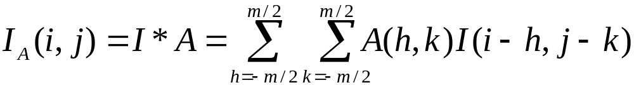

Linear Filtering – convolution
The output is the linear combination of the neighbourhood pixels
The coefficients come from a constant matrix A, called kernel.
This process, denoted by ‘*’, is called (discrete) convolution.
1 | 3 | 0
2 | 10 | 2
4 | 1 | 1
1 | 0 | -1
1 | 0.1 | -1
1 | 0 | -1
 | 5
=
Image
Kernel
Filter Output

Slide 4
Handle Border Pixels
Near the borders of the image, some pixels do not have enough
neighbours. Two possible solutions are:
Set the value of all non-included pixels to zero.
Set all non-included pixels to the value of the corresponding pixel in the input image.

Slide 5
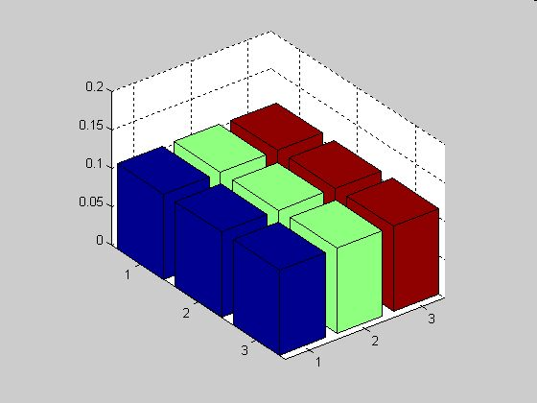
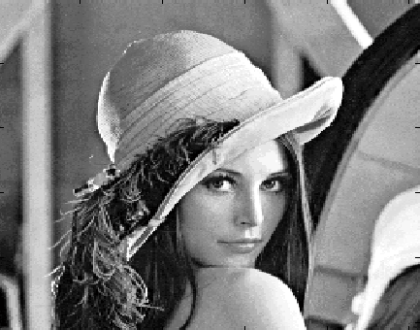
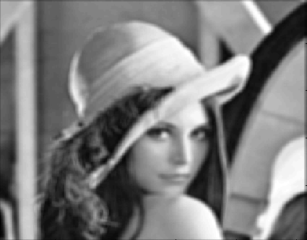


Smoothing by Averaging
1 | 1 | 1
1 | 1 | 1
1 | 1 | 1
Convolution can be understood as weighted averaging.

Slide 6
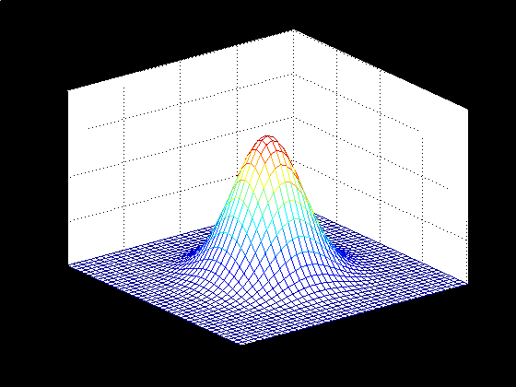
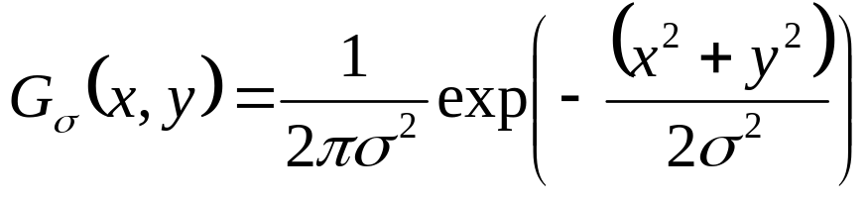
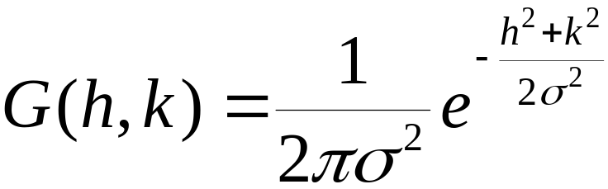
Gaussian Filter
Discrete Gaussian kernel:

Slide 7
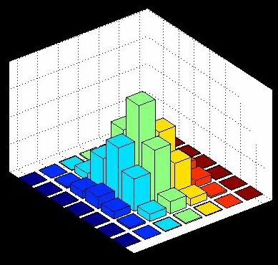
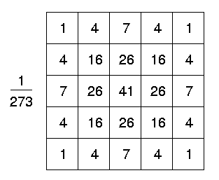
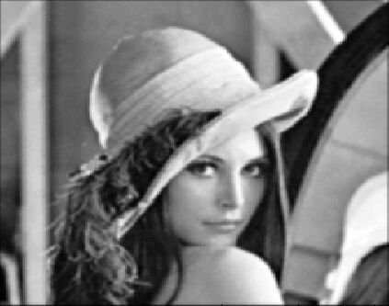


Gaussian Filter

Slide 8
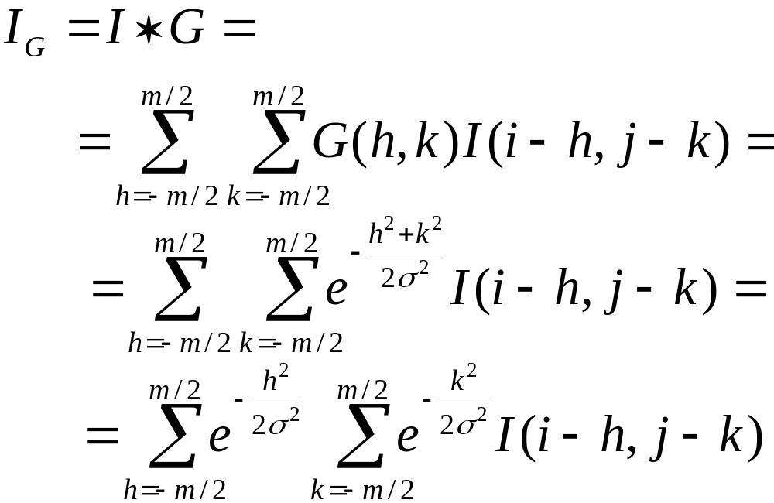
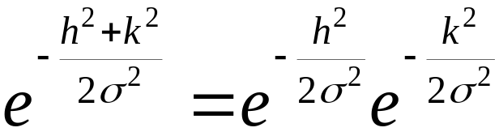
Gaussian Kernel is Separable
since

Slide 9




Gaussian Kernel is Separable
Convolving rows and then columns with a 1-D Gaussian kernel.
I
1
9
18
9
1
=
Ir
1
9
Ir
18
=
result
9
1
The complexity increases linearly with instead of with .

Slide 10

Gaussian vs. Average
Gaussian Smoothing
Smoothing by Averaging

Slide 11
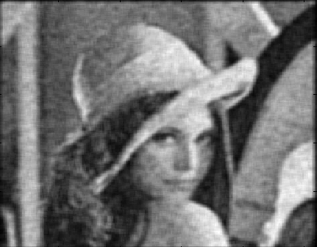
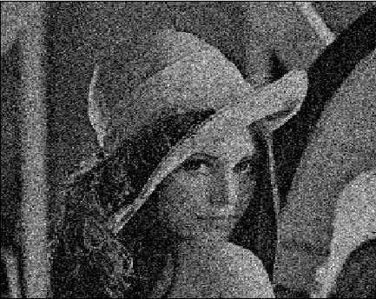
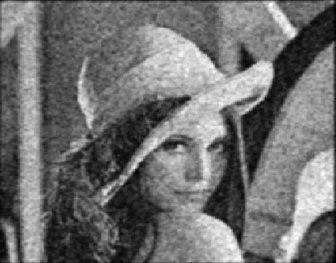
Noise Filtering
After Averaging
Gaussian Noise
After Gaussian Smoothing

Slide 12

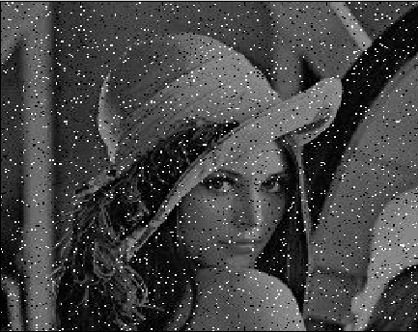
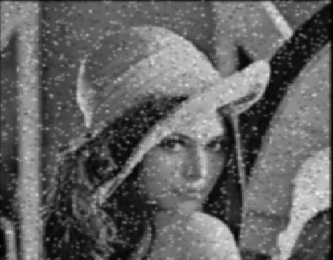
Noise Filtering
After averaging
Salt-and-pepper noise
After Gaussian smoothing

Slide 13
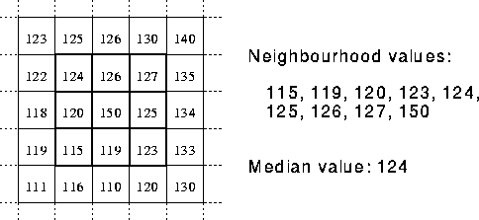
Nonlinear Filtering – median filter
Replace each pixel value I(i, j) with the median of the values
found in a local neighbourhood of (i, j).

Slide 14
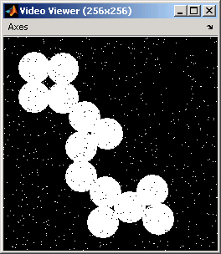

Median Filter
Salt-and-pepper noise
After median filtering

Slide 15
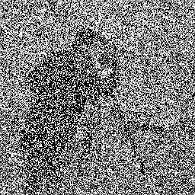
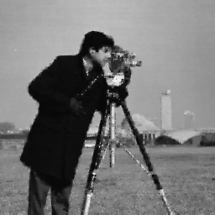
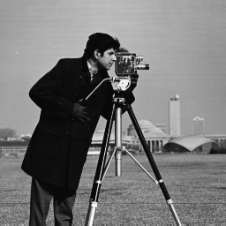
Salt-and-Pepper Noise Removal by Median-type Noise Detectors and Edge-preserving Regularization
Raymond H. Chan, Chung-Wa Ho, and Mila Nikolova
IEEE Transactions on Image Processing, 14 (2005), 1479-1485.

